Slide 1
Graph Representation Learning
William L. Hamilton

Slide 2
Chapter 1: Introduction

Slide 3
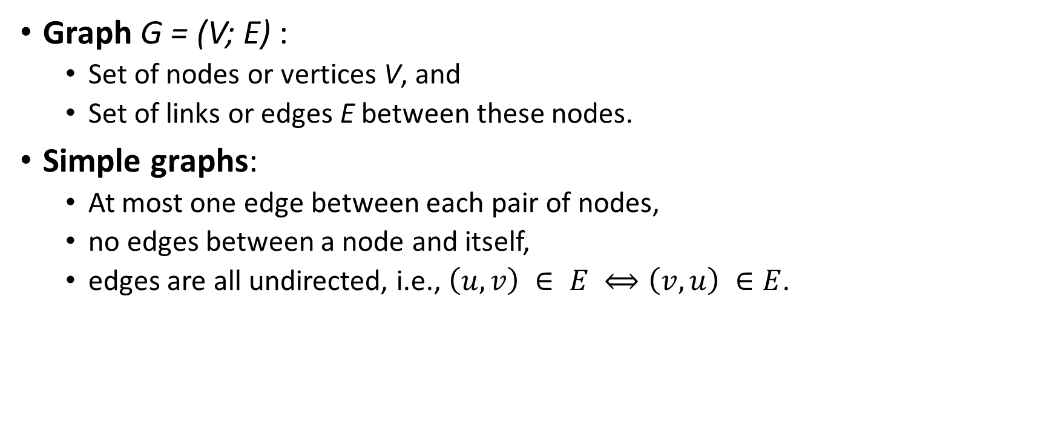
Definitions
Graph G = (V; E) :
Set of nodes or vertices V, and
Set of links or edges E between these nodes.
Simple graphs:
At most one edge between each pair of nodes,
no edges between a node and itself,
edges are all undirected, i.e., $\left(u, v\right) ∈ E ⟺\left(v, u\right) ∈E$.

Slide 4
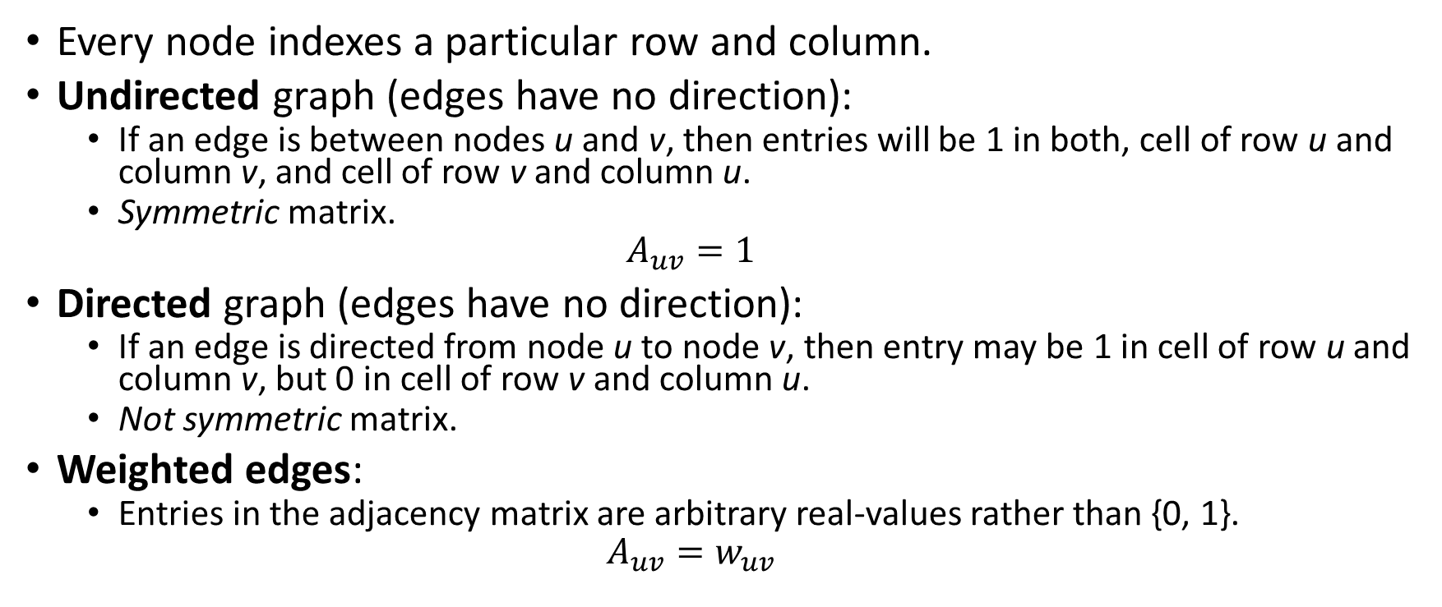
Adjacency matrix
Every node indexes a particular row and column.
Undirected graph (edges have no direction):
If an edge is between nodes u and v, then entries will be 1 in both, cell of row u and column v, and cell of row v and column u.
Symmetric matrix.
$$A_{uv}=1$$
Directed graph (edges have no direction):
If an edge is directed from node u to node v, then entry may be 1 in cell of row u and column v, but 0 in cell of row v and column u.
Not symmetric matrix.
Weighted edges:
Entries in the adjacency matrix are arbitrary real-values rather than {0, 1}.
$$A_{uv}=w_{uv}$$

Slide 5
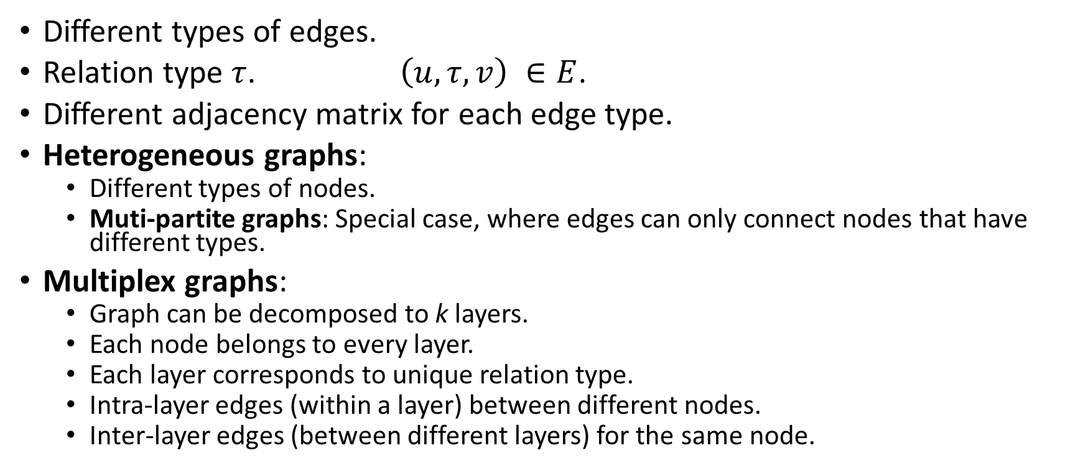
Multi-relational graphs
Different types of edges.
Relation type $τ$. $\left(u, τ, v\right) ∈E$.
Different adjacency matrix for each edge type.
Heterogeneous graphs:
Different types of nodes.
Muti-partite graphs: Special case, where edges can only connect nodes that have different types.
Multiplex graphs:
Graph can be decomposed to k layers.
Each node belongs to every layer.
Each layer corresponds to unique relation type.
Intra-layer edges (within a layer) between different nodes.
Inter-layer edges (between different layers) for the same node.

Slide 6
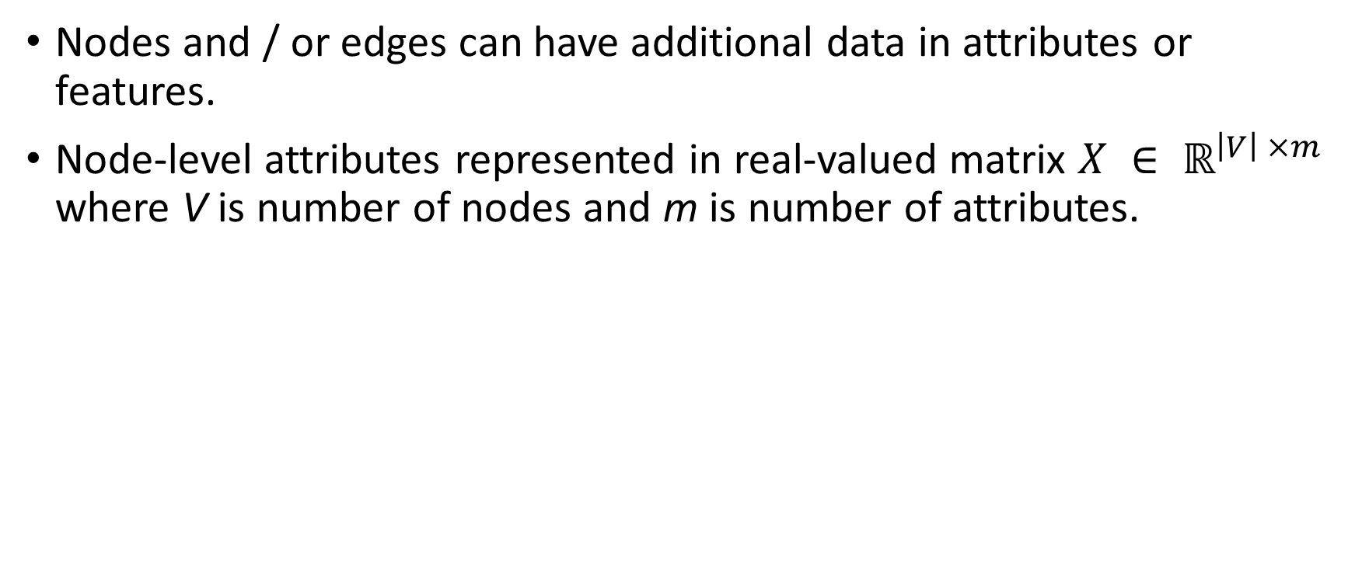
Attributes or features
Nodes and / or edges can have additional data in attributes or features.
Node-level attributes represented in real-valued matrix $X ∈ ℝ^{\left|V\right| ×m}$ where V is number of nodes and m is number of attributes.

Slide 7
Nomenclature
“Graph”:
Term preferred by machine learning community.
Abstract data structure.
“Network”:
Term preferred by data mining and network science communities.
Specific, real-world instantiations of this data structure (e.g., social networks).

Slide 8
Machine learning on graphs
(1) Node classification (semi-supervised):
Given: all data of all edges, and all data of some nodes (training set).
Predict: data of remaining nodes (test set).
Examples:
Classify social network nodes as humans (users) or computer programs (bots),
classifying proteins’ function,
classifying documents’ topics based on hyperlink or citation graphs, etc.
Difference from standard supervised classification: nodes in a graph are not independent and identically distributed (IID).
Explicitly leverage connections between nodes:
Homophily: tendency for nodes to share attributes with their neighbors in the graph.
Structural equivalence: nodes with similar local neighborhood structures will have similar labels.
Heterophily: nodes will be preferentially connected to nodes with different labels.

Slide 9
Machine learning on graphs (continued)
(2) Relation prediction (semi-supervised):
Given: all data of all nodes, and all data of some edges (training set).
Predict: remaining edges and their data (test set).
Complexity depends on type of graph data.
Examples:
recommending content to users in social platforms,
predicting drug side-effects,
inferring new facts in a relational databases, etc.

Slide 10
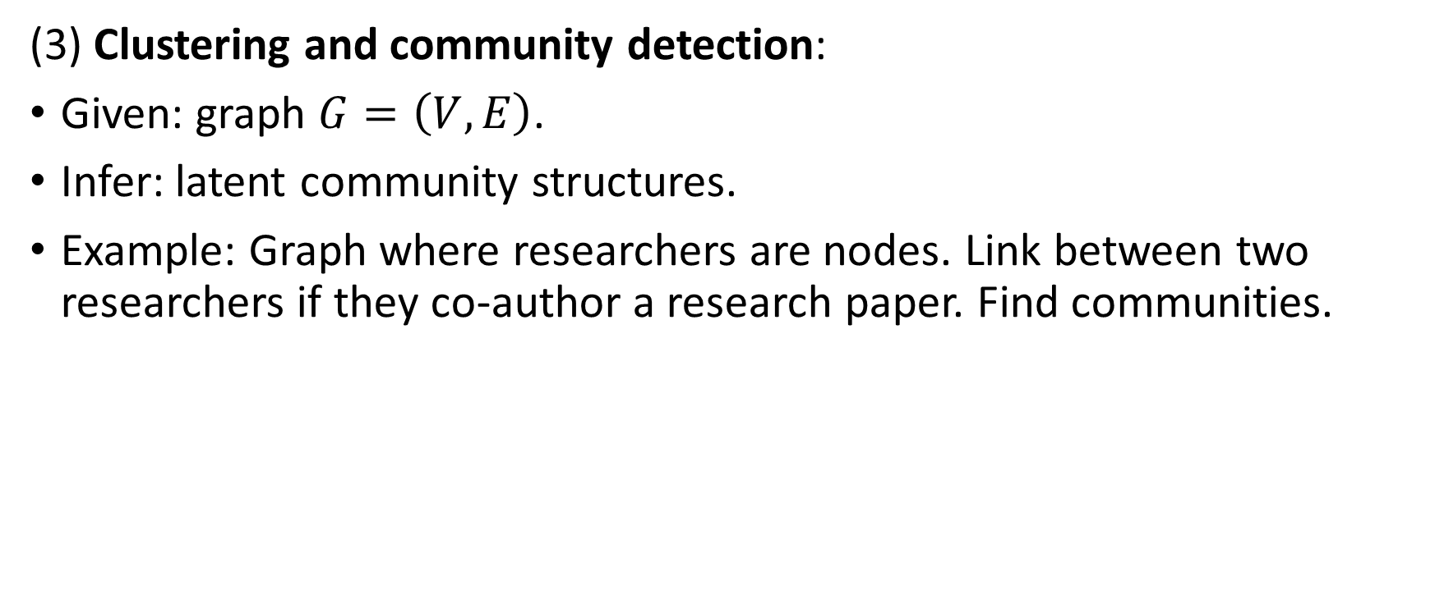
Machine learning on graphs (continued)
(3) Clustering and community detection:
Given: graph $G=\left(V, E\right)$.
Infer: latent community structures.
Example: Graph where researchers are nodes. Link between two researchers if they co-author a research paper. Find communities.

Slide 11
Machine learning on graphs (continued)
(4) Graph classification, regression, and clustering:
Perform task on multiple entire graphs.
Embeddings about nodes, edges, graphs, etc.
Examples:
Graphs representing molecules’ structures: regression to predict molecules’ toxicity or solubility.
Graphs representing programs’ syntax and data flow: classify programs as malicious or not.
Make independent predictions specific to each graph.
Each graph is independent and identically distributed data point.
Graph clustering: learn an unsupervised measure of similarity between pairs of graphs.
Challenge: Defining useful features that take into account the relational structure within each graph.

Slide 12
Chapter 2: Background and Traditional Approaches

Slide 13
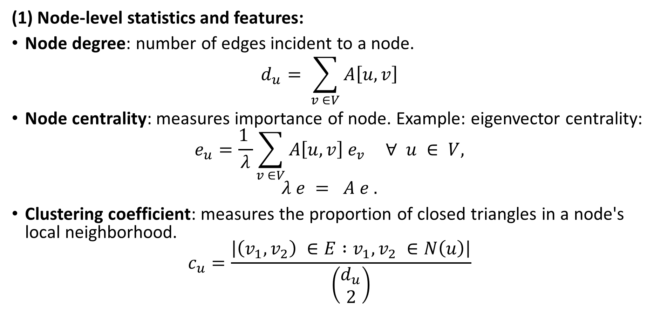
Graph Statistics and Kernel Methods
(1) Node-level statistics and features:
Node degree: number of edges incident to a node.
$$d_{u}= \sum_{v ∈V}{A\left[u, v\right]}$$
Node centrality: measures importance of node. Example: eigenvector centrality:
$$e_{u}=\frac{1 }{λ}\sum_{v ∈V}{A\left[u, v\right] e_{v}} ∀ u ∈ V,$$
$$λ e = A e .$$
Clustering coefficient: measures the proportion of closed triangles in a node's local neighborhood.
$$c_{u}=\frac{\left|\left(v_{1}, v_{2}\right) ∈E :v_{1}, v_{2} ∈N\left(u\right)\right|}{\left(\begin{matrix}d_{u} \\ 2\end{matrix}\right)}$$

Slide 14
Graph Statistics and Kernel Methods (continued)
Closed triangles, ego graphs, and motifs:
Ego graph of a node: subgraph containing that node, its neighbors, and all the edges between nodes in its neighborhood. (include figure)
Motifs or graphlets within a node's ego graph: rather than just counting triangles, we could consider more complex structures, such as cycles of particular length. We could characterize nodes by counts of how often these different motifs occur in their ego graph. (include figure)

Slide 15
Graph Statistics and Kernel Methods (continued)
(2) Graph-level features and graph kernels:
Bag of nodes:
Aggregate of node-level statistics, used as a graph-level representation.
Algorithm is independent of node ordering.
Disadvantage: entirely based upon local node-level information. May miss important global properties in the graph.
Weisfeiler-Lehman kernel:
Iterative neighborhood aggregation: Extract node-level features that contain more information than just their local ego graph. Aggregate these richer features into a graph-level representation.

Slide 16
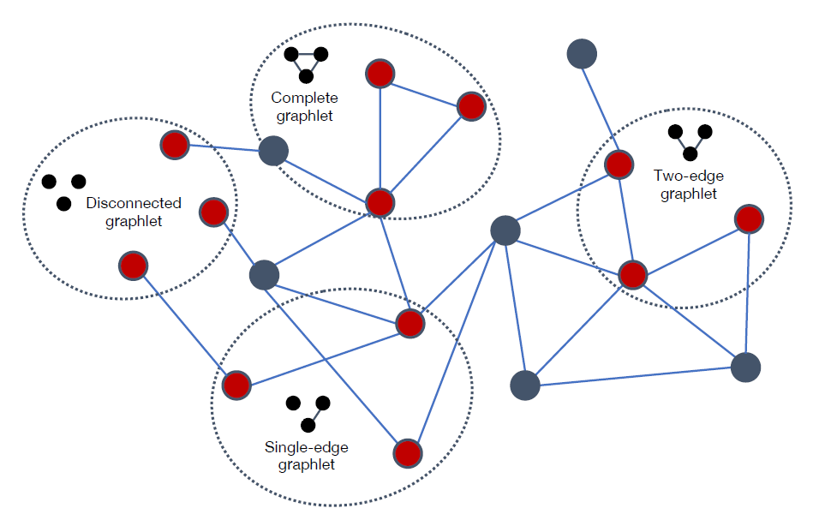
Graph Statistics and Kernel Methods (continued)
Graphlets and path-based methods:
Graphlets: small subgraph structures. Challenge: counting these is a combinatorically difficult problem.
Path-based methods: Examine different kinds of paths that occur in a graph.
Describe kernel methods of graphs. Check blogs,
Figure 2.2: The four different size-3 graphlets that can occur in a simple graph.

Slide 17
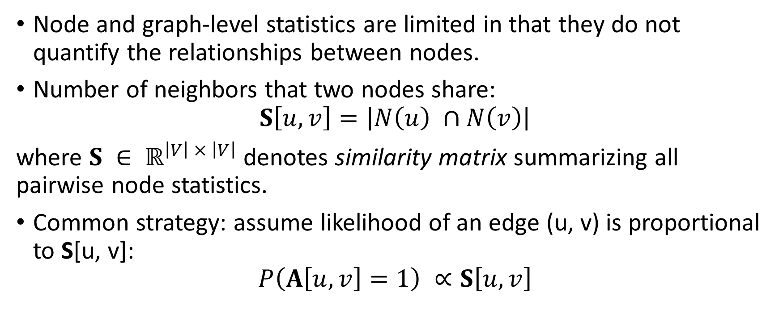
Neighborhood Overlap Detection
Node and graph-level statistics are limited in that they do not quantify the relationships between nodes.
Number of neighbors that two nodes share:
$$S\left[u, v\right]=\left|N\left(u\right) ∩N\left(v\right)\right|$$
where $S ∈ ℝ^{\left|V\right| × \left|V\right|}$ denotes similarity matrix summarizing all pairwise node statistics.
Common strategy: assume likelihood of an edge (u, v) is proportional to S[u, v]:
$$P\left(A\left[u, v\right]=1\right) ∝S\left[u, v\right]$$

Slide 18
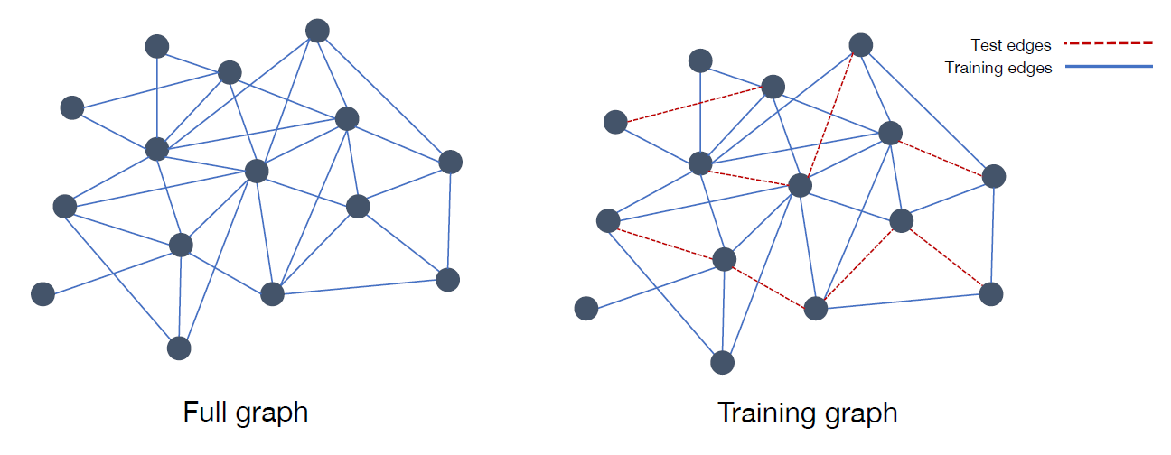
Full graph and a subsampled graph used for training.
Dotted edges in training graph are removed when training a model or computing overlap statistics.
Model is evaluated based on its ability to predict existence of these held-out test edges.

Slide 19
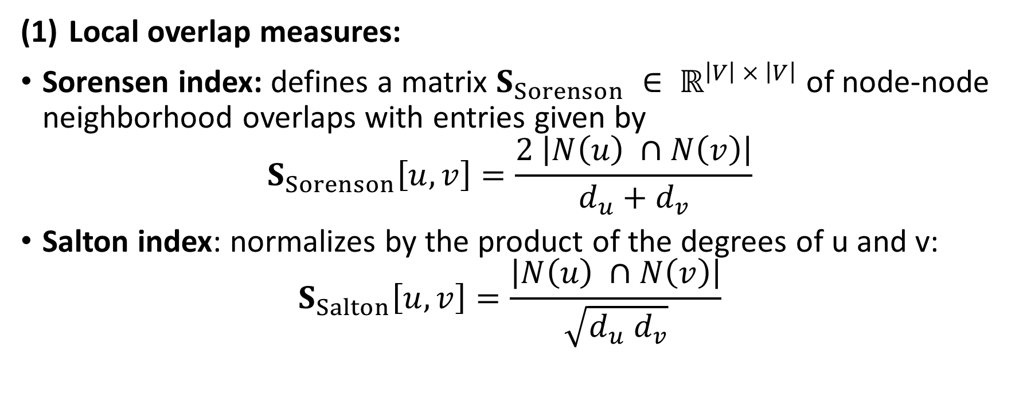
Neighborhood Overlap Detection (continued)
Local overlap measures:
Sorensen index: defines a matrix $S_{Sorenson} ∈ ℝ^{\left|V\right| × \left|V\right|}$ of node-node neighborhood overlaps with entries given by
$$S_{Sorenson}\left[u, v\right]=\frac{2 \left|N\left(u\right) ∩N\left(v\right)\right|}{d_{u}+d_{v}}$$
Salton index: normalizes by the product of the degrees of u and v:
$$S_{Salton}\left[u, v\right]=\frac{\left|N\left(u\right) ∩N\left(v\right)\right|}{\sqrt{d_{u} d_{v}}}$$
Notes:
Number of common neighbors divided by average degree.

Slide 20
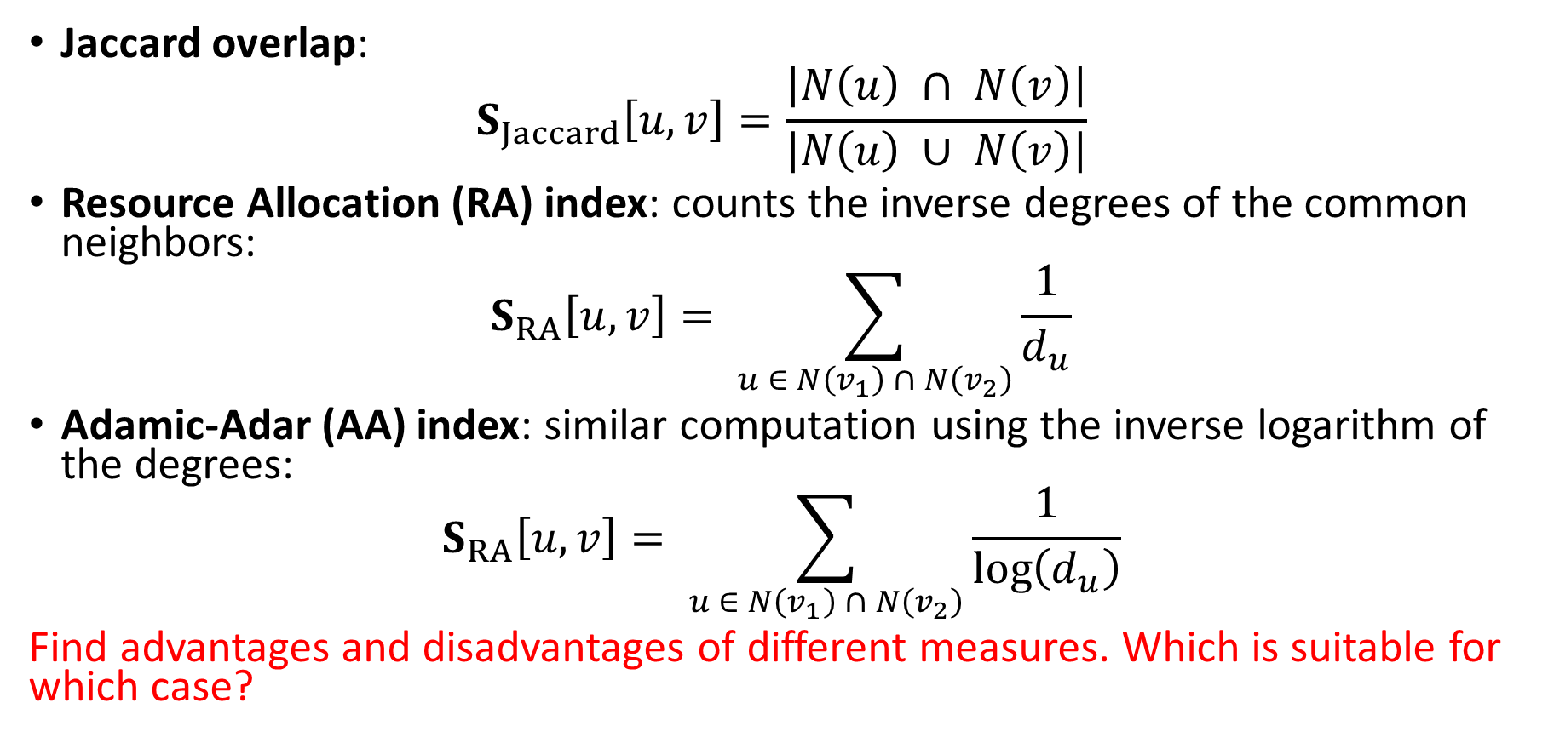
Neighborhood Overlap Detection (continued)
Jaccard overlap:
$$S_{Jaccard}\left[u, v\right]=\frac{\left|N\left(u\right) ∩ N\left(v\right)\right|}{\left|N\left(u\right) ∪ N\left(v\right)\right|}$$
Resource Allocation (RA) index: counts the inverse degrees of the common neighbors:
$$S_{RA}\left[u, v\right]= \sum_{u ∈ N\left(v_{1}\right) ∩ N\left(v_{2}\right)}{\frac{1}{d_{u}}}$$
Adamic-Adar (AA) index: similar computation using the inverse logarithm of the degrees:
$$S_{RA}\left[u, v\right]= \sum_{u ∈ N\left(v_{1}\right) ∩ N\left(v_{2}\right)}{\frac{1}{\log\left(d_{u}\right)}}$$
Find advantages and disadvantages of different measures. Which is suitable for which case?

Slide 21
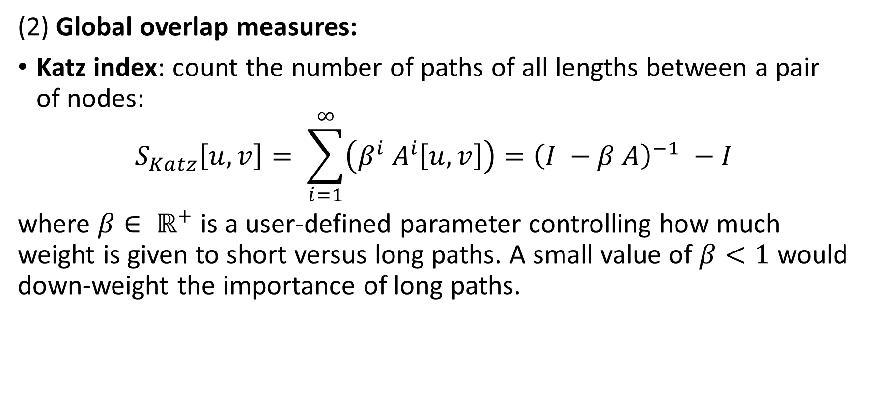
Neighborhood Overlap Detection (continued)
(2) Global overlap measures:
Katz index: count the number of paths of all lengths between a pair of nodes:
$$S_{Katz}\left[u, v\right]= \sum_{i=1}^{∞}{\left(β^{i} A^{i}\left[u, v\right]\right)}={\left(I −β A\right)}^{−1} −I$$
where $β∈ ℝ^{+}$ is a user-defined parameter controlling how much weight is given to short versus long paths. A small value of $β<1$ would down-weight the importance of long paths.

Slide 22
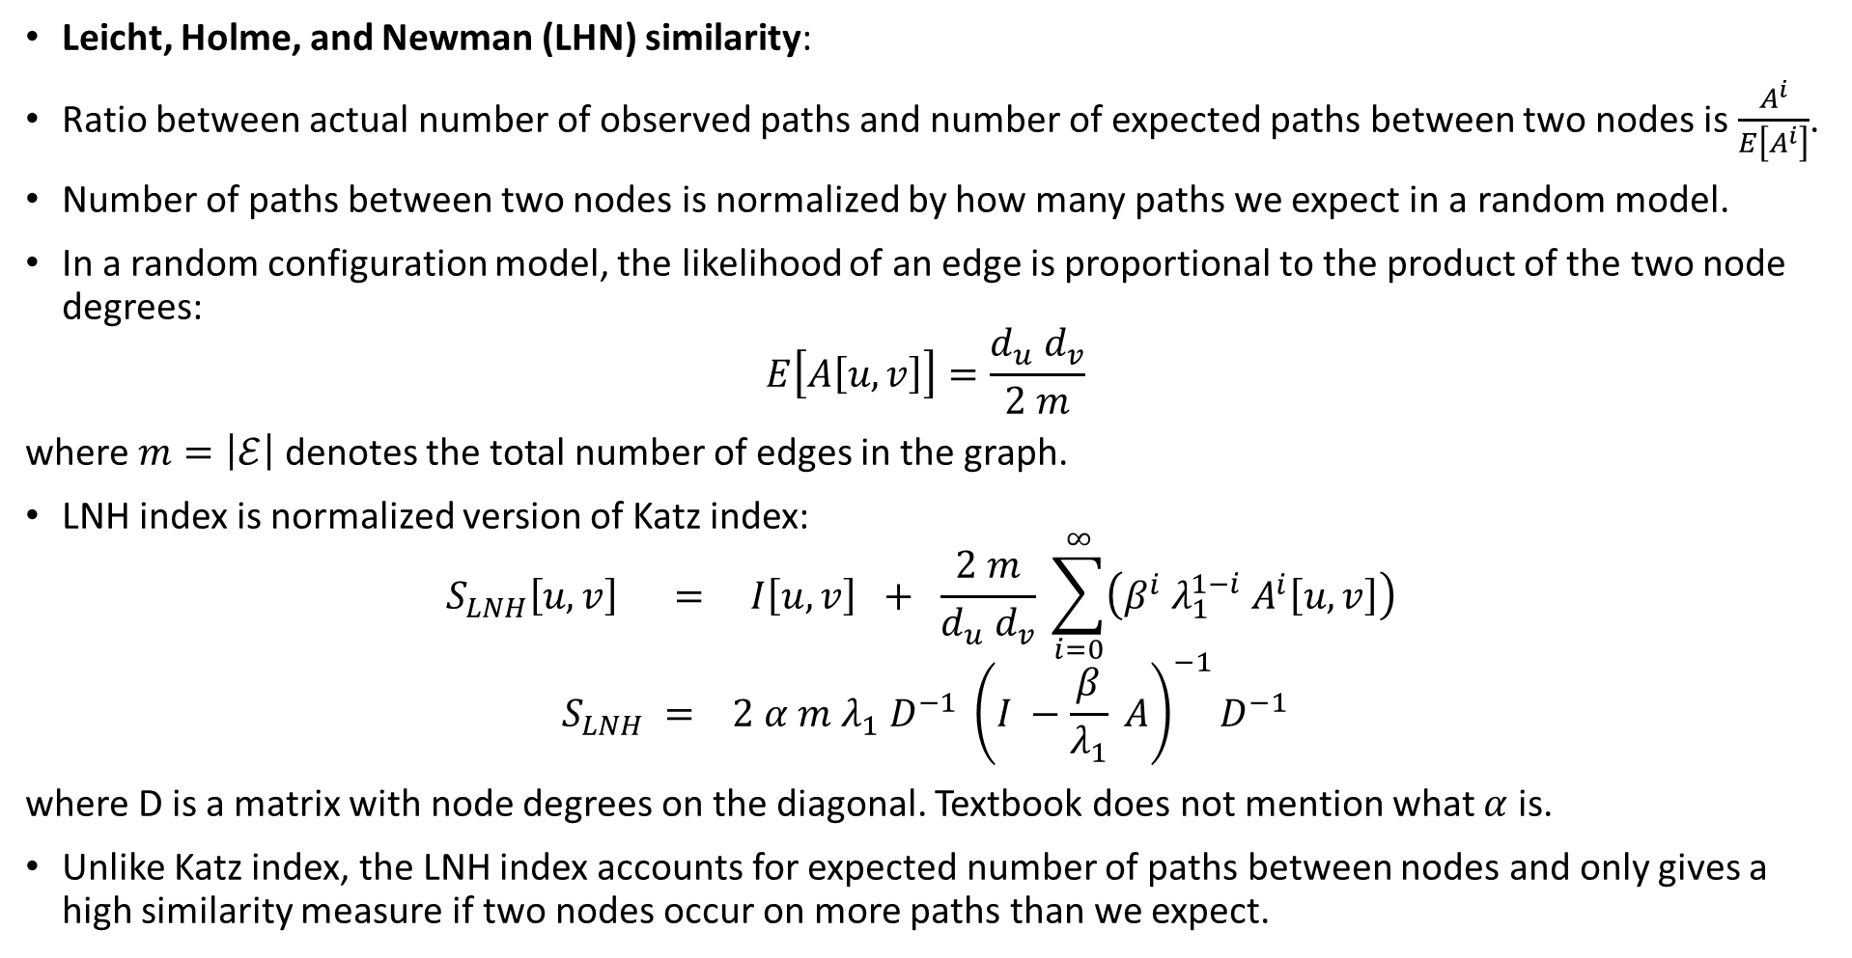
Neighborhood Overlap Detection (continued)
Leicht, Holme, and Newman (LHN) similarity:
Ratio between actual number of observed paths and number of expected paths between two nodes is $\frac{A^{i}}{E\left[A^{i}\right]}$.
Number of paths between two nodes is normalized by how many paths we expect in a random model.
In a random configuration model, the likelihood of an edge is proportional to the product of the two node degrees:
$$E\left[A\left[u, v\right]\right]=\frac{d_{u} d_{v}}{2 m}$$
where $m=\left|ℰ\right|$ denotes the total number of edges in the graph.
LNH index is normalized version of Katz index:
$$S_{LNH}\left[u, v\right] = I\left[u, v\right] + \frac{2 m}{d_{u} d_{v}} \sum_{i=0}^{∞}{\left(β^{i} λ_{1}^{1−i} A^{i}\left[u, v\right]\right)}$$
$$S_{LNH} = 2 α m λ_{1} D^{−1} {\left(I −\frac{β}{λ_{1}} A\right)}^{−1}D^{−1}$$
where D is a matrix with node degrees on the diagonal. Textbook does not mention what $α$ is.
Unlike Katz index, the LNH index accounts for expected number of paths between nodes and only gives a high similarity measure if two nodes occur on more paths than we expect.

Slide 23
Chapter 3: Neighborhood Reconstruction Methods

Slide 24
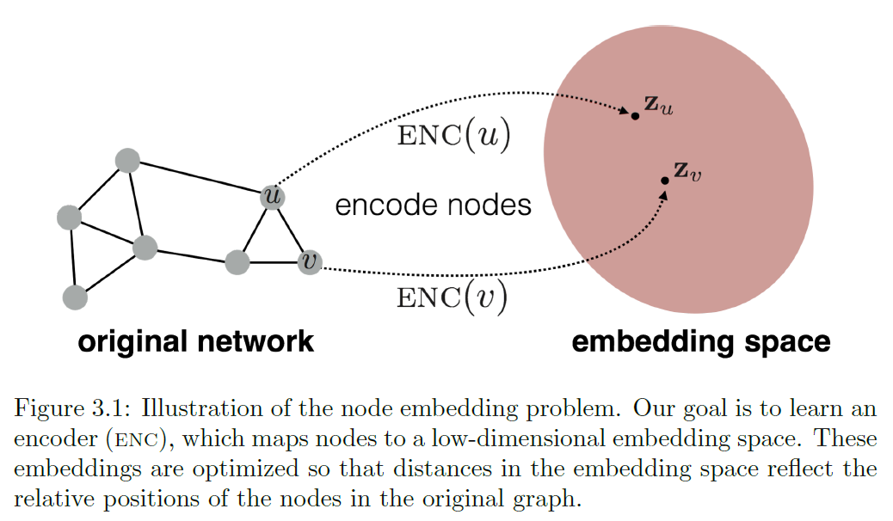
Methods for learning node embeddings.
Encode nodes as low-dimensional vectors that summarize their graph position and the structure of their local graph neighborhood.

Slide 25
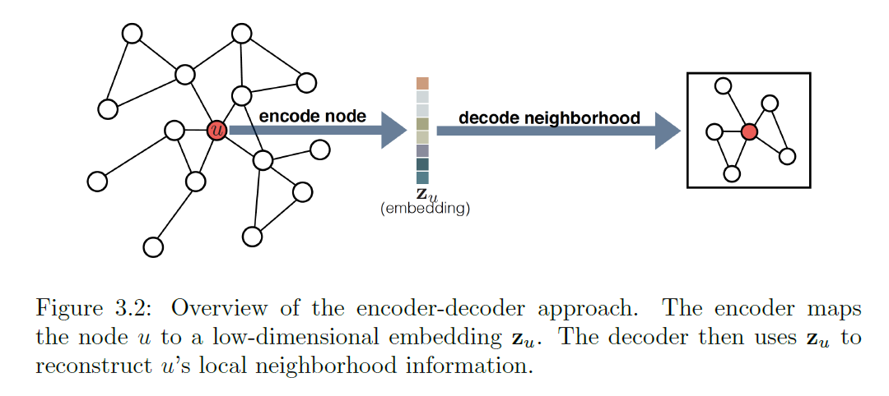
Encoder-Decoder Perspective
Encoder model maps each node in the graph into a low-dimensional vector or embedding.
Decoder model takes the low-dimensional node embeddings and uses them to reconstruct information about each node's neighborhood in the original graph.

Slide 26
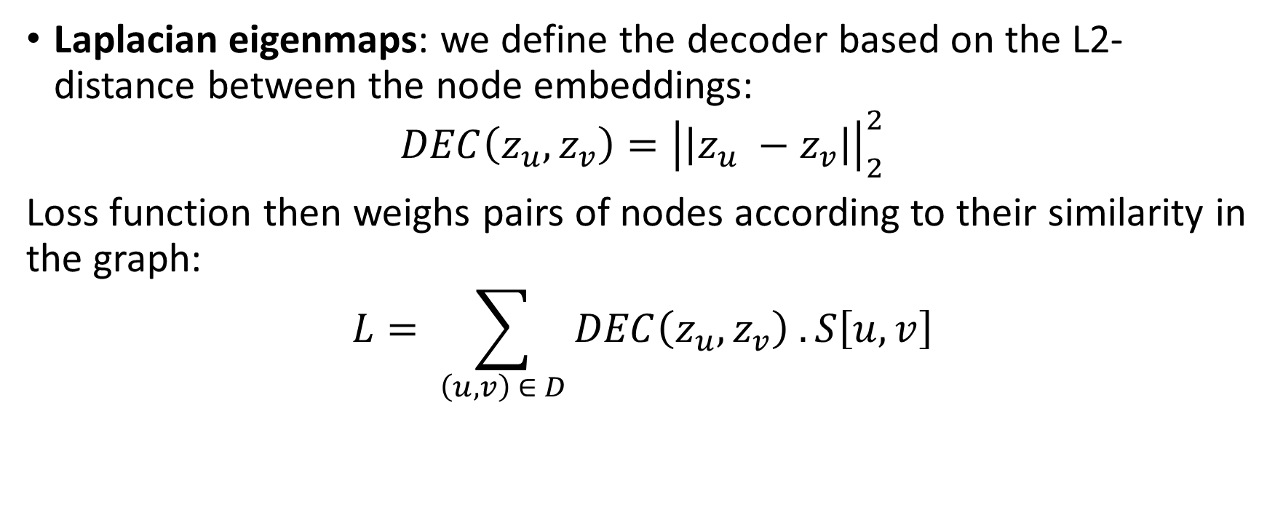
Factorization-based approaches
Laplacian eigenmaps: we define the decoder based on the L2-distance between the node embeddings:
$$DEC\left(z_{u}, z_{v}\right)={\left|\left|z_{u} −z_{v}\right|\right|}_{2}^{2}$$
Loss function then weighs pairs of nodes according to their similarity in the graph:
$$L= \sum_{\left(u, v\right) ∈ D}{DEC\left(z_{u}, z_{v}\right) . S\left[u, v\right]}$$

Slide 27
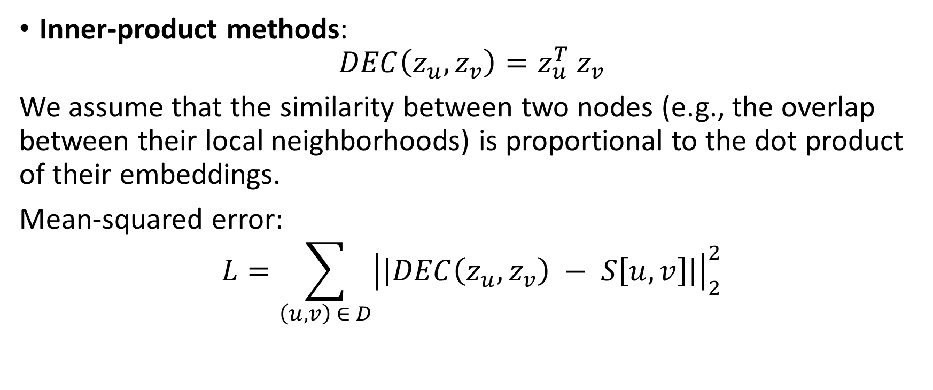
Factorization-based approaches (continued)
Inner-product methods:
$$DEC\left(z_{u}, z_{v}\right)=z_{u}^{T} z_{v}$$
We assume that the similarity between two nodes (e.g., the overlap between their local neighborhoods) is proportional to the dot product of their embeddings.
Mean-squared error:
$$L=\sum_{\left(u, v\right) ∈ D}{{\left|\left|DEC\left(z_{u}, z_{v}\right) − S\left[u, v\right]\right|\right|}_{2}^{2}}$$

Slide 28
Random walk embeddings
Inner-product methods discussed earlier all employ deterministic measures of node similarity.
Another approach: use stochastic measures of neighborhood overlap.
Node embeddings are optimized so that two nodes have similar embeddings if they tend to co-occur on short random walks over the graph.

Slide 29
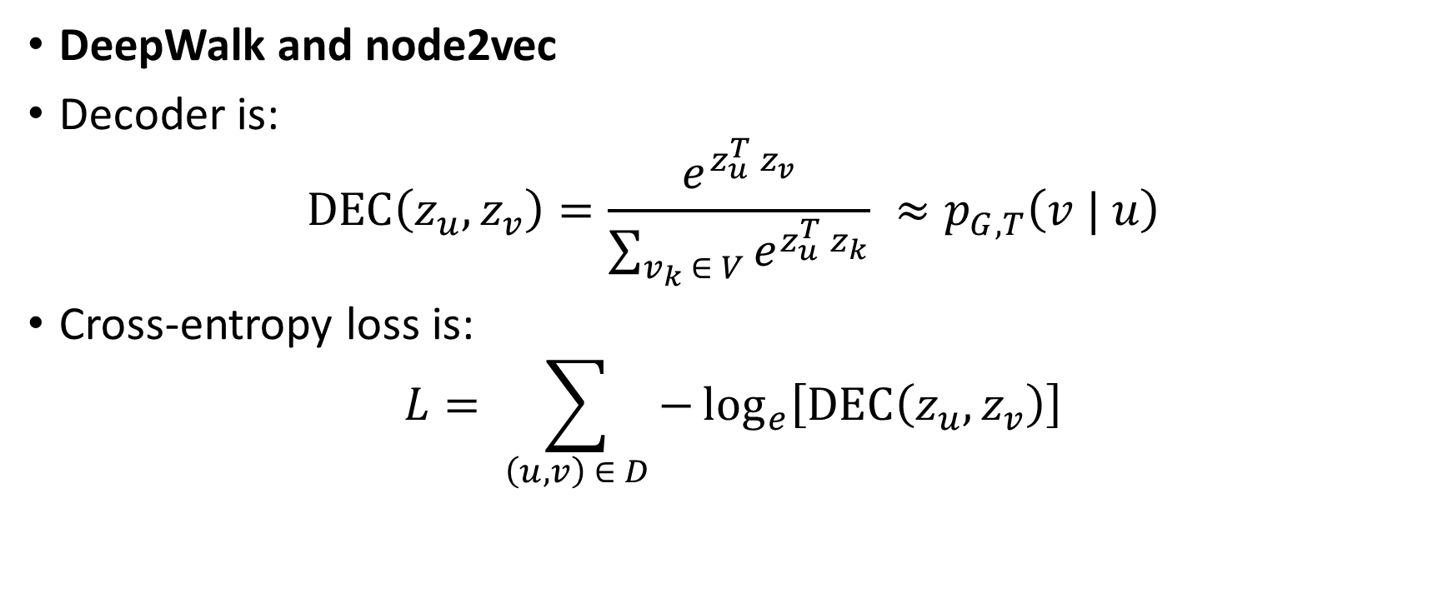
Random walk embeddings (continued)
DeepWalk and node2vec
Decoder is:
$$DEC\left(z_{u}, z_{v}\right)=\frac{e^{z_{u}^{T} z_{v}}}{\sum_{v_{k} ∈ V}{e^{z_{u}^{T} z_{k}}}} ≈p_{G, T}\left(v | u\right)$$
Cross-entropy loss is:
$$L= \sum_{\left(u, v\right) ∈ D}{−\log_{e}\left[DEC\left(z_{u}, z_{v}\right)\right]}$$

Slide 30
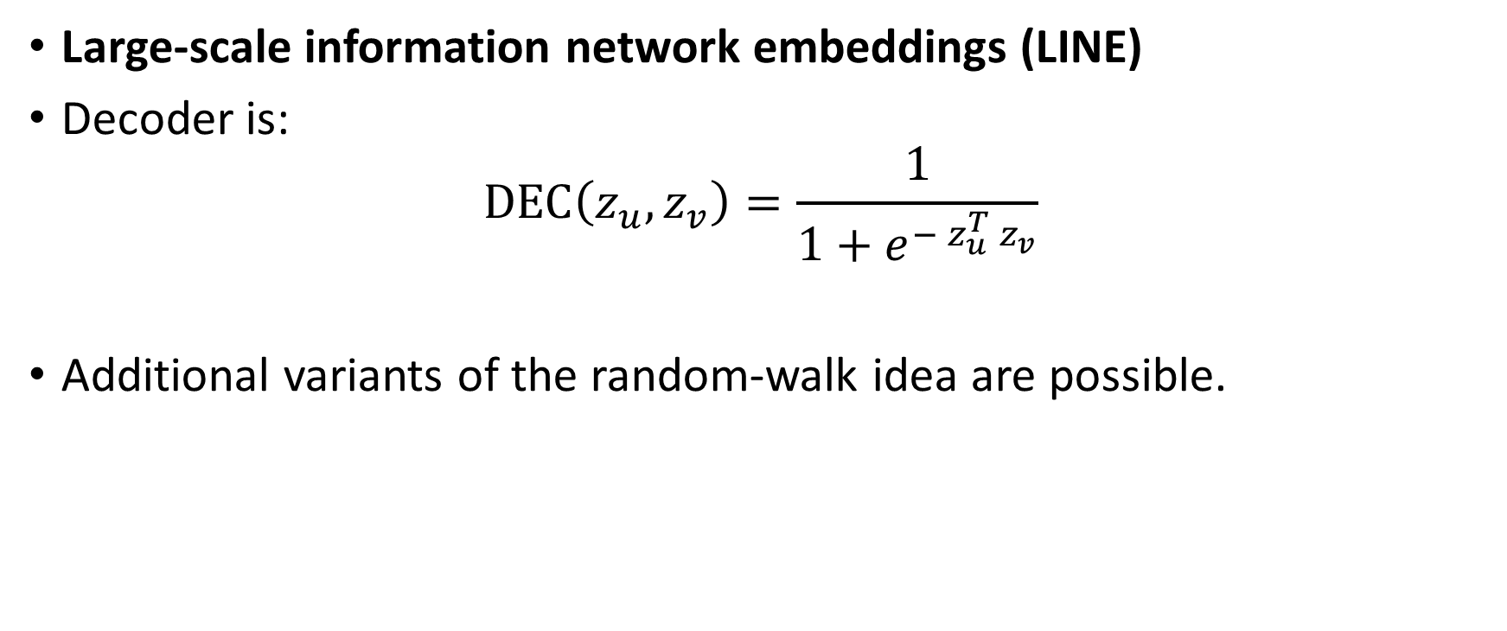
Random walk embeddings (continued)
Large-scale information network embeddings (LINE)
Decoder is:
$$DEC\left(z_{u}, z_{v}\right)=\frac{1}{1+e^{− z_{u}^{T} z_{v}}}$$
Additional variants of the random-walk idea are possible.

Slide 31
Limitations of Shallow Embeddings
Do not share any parameters between nodes in the encoder, since the encoder directly optimizes a unique embedding vector for each node.
Do not leverage node features in the encoder.
Inherently transductive.
To alleviate these limitations, shallow encoders can be replaced with more sophisticated encoders that depend more generally on the structure and attributes of the graph.

Slide 32
Chapter 4: Multi-relational Data and Knowledge Graphs

Slide 33
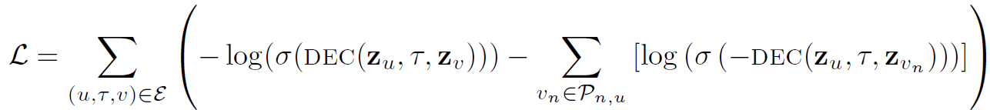
Loss functions
Cross-entropy with negative sampling:
Using a Monte Carlo approximation, the most popular form is:

Slide 34
Loss functions (continued)
Max-margin loss:

Slide 35
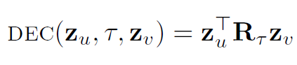
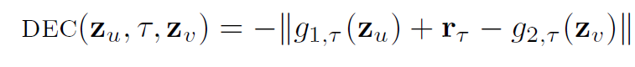
Multi-relational decoders
Translational decoders:
TransE model:
TransX model:
TransH model:

Slide 36
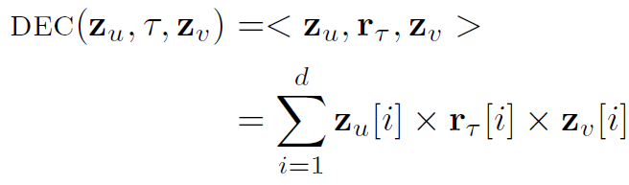
Multi-relational decoders (continued)
Multi-linear dot products:
(DistMult):

Slide 37
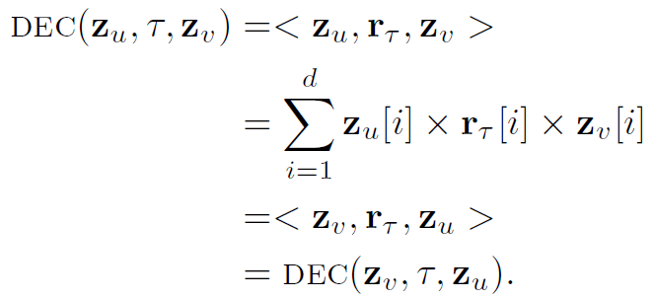
Multi-relational decoders (continued)
Complex decoders:
Limitation of the DistMult decoder: it can only encode symmetric relations.
This is a serious limitation as many relation types in multi-relational graphs are directed and asymmetric.

Slide 38
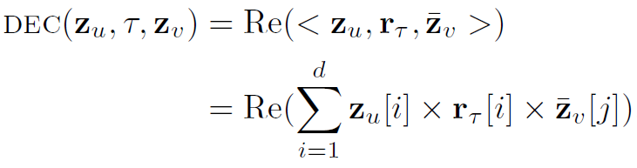
Multi-relational decoders (continued)
Solution: augmenting the DistMult encoder by employing complex-valued embeddings. ComplEx:
Related approach, RotatE: defines the decoder as rotations in the complex plane:
where o denotes the Hadamard product.

Slide 39
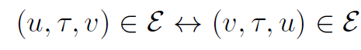
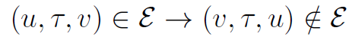
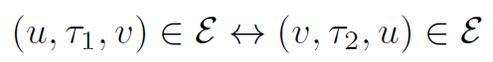
Multi-relational decoders (continued)
Representational abilities:
Properties to characterize the various multi-relational decoders, in terms of their ability to represent different logical patterns on relations.
Symmetry:
Anti-symmetry:
Inversion:
Compositonality:

Slide 40
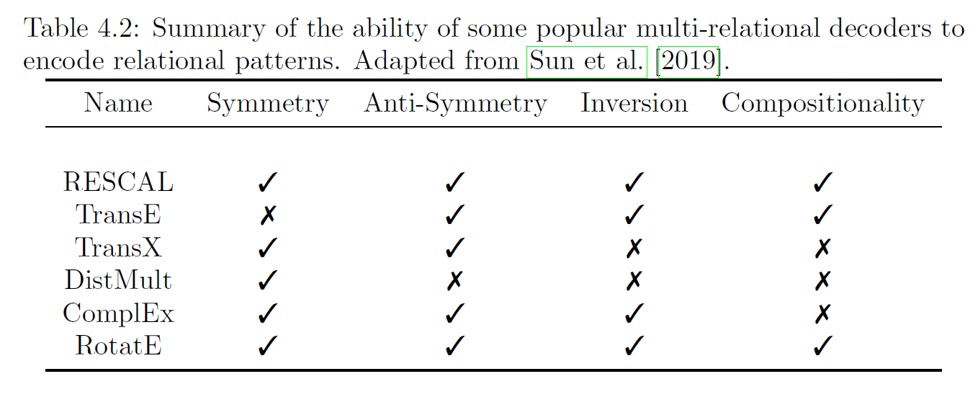
Multi-relational decoders (continued)

Slide 41
Chapter 5: The Graph Neural Network Model

Slide 42
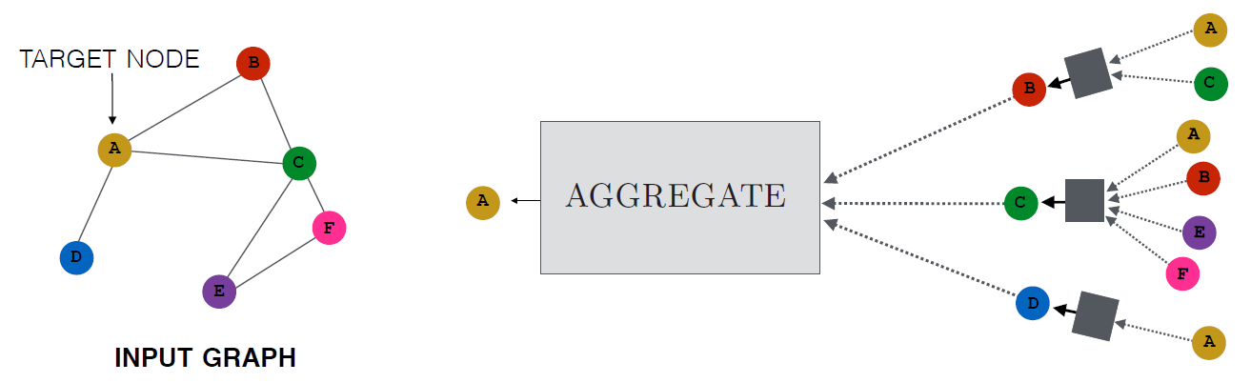
Neural Message Passing: Overview
Model aggregates messages from A's local graph neighbors.
In turn, messages coming from these neighbors are based on information aggregated from their respective neighborhoods, and so on.
Computation graph of GNN forms tree structure by unfolding neighborhood around target node.

Slide 43
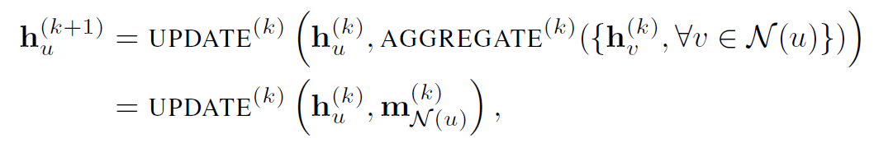
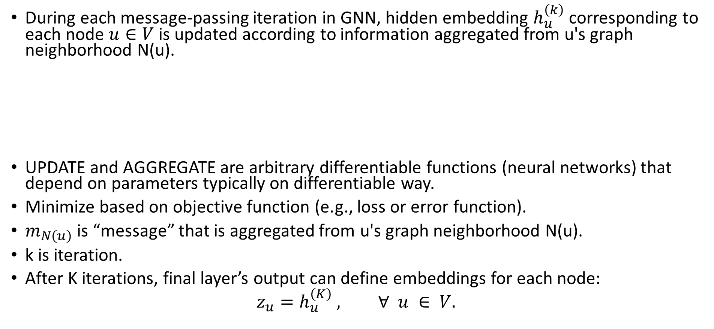
Neural Message Passing (continued)
During each message-passing iteration in GNN, hidden embedding $h_{u}^{\left(k\right)}$ corresponding to each node $u∈V$ is updated according to information aggregated from u's graph neighborhood N(u).
UPDATE and AGGREGATE are arbitrary differentiable functions (neural networks) that depend on parameters typically on differentiable way.
Minimize based on objective function (e.g., loss or error function).
$m_{N\left(u\right)}$ is “message” that is aggregated from u's graph neighborhood N(u).
k is iteration.
After K iterations, final layer’s output can define embeddings for each node:
$$z_{u}=h_{u}^{\left(K\right)} , ∀ u ∈ V.$$

Slide 44
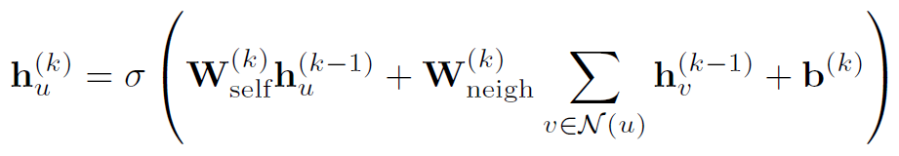
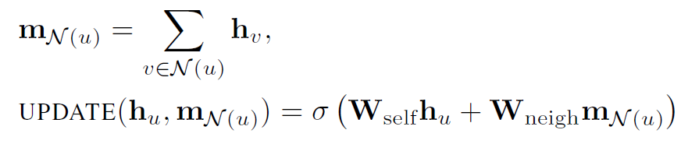
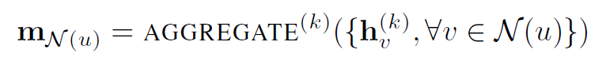
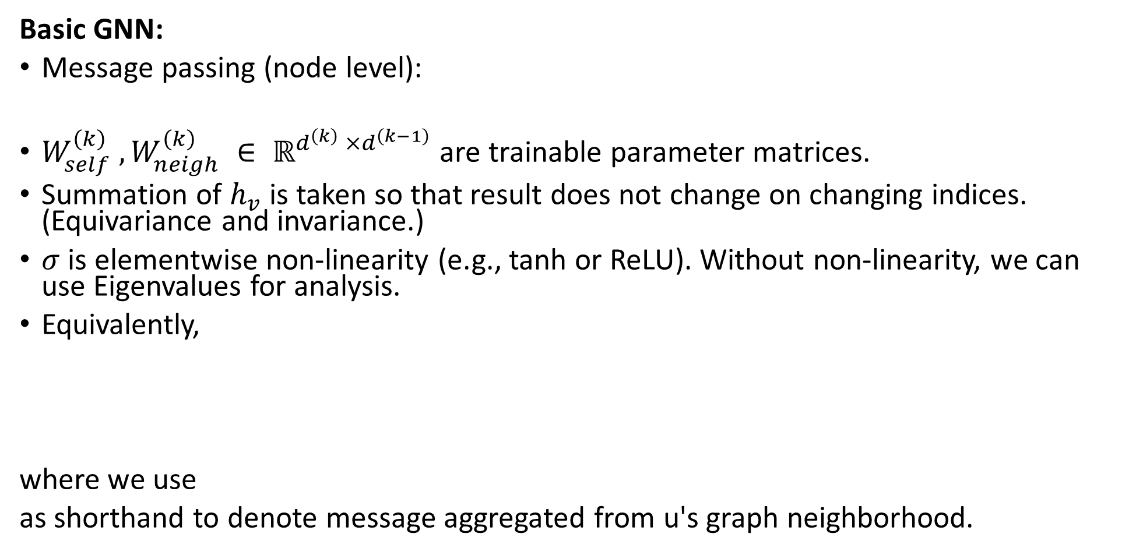
Neural Message Passing (continued)
Basic GNN:
Message passing (node level):
$W_{self}^{\left(k\right)} , W_{neigh}^{\left(k\right)} ∈ ℝ^{d^{\left(k\right)} ×d^{\left(k−1\right)}}$ are trainable parameter matrices.
Summation of $h_{v}$ is taken so that result does not change on changing indices. (Equivariance and invariance.)
$σ$ is elementwise non-linearity (e.g., tanh or ReLU). Without non-linearity, we can use Eigenvalues for analysis.
Equivalently,
where we use
as shorthand to denote message aggregated from u's graph neighborhood.

Slide 45
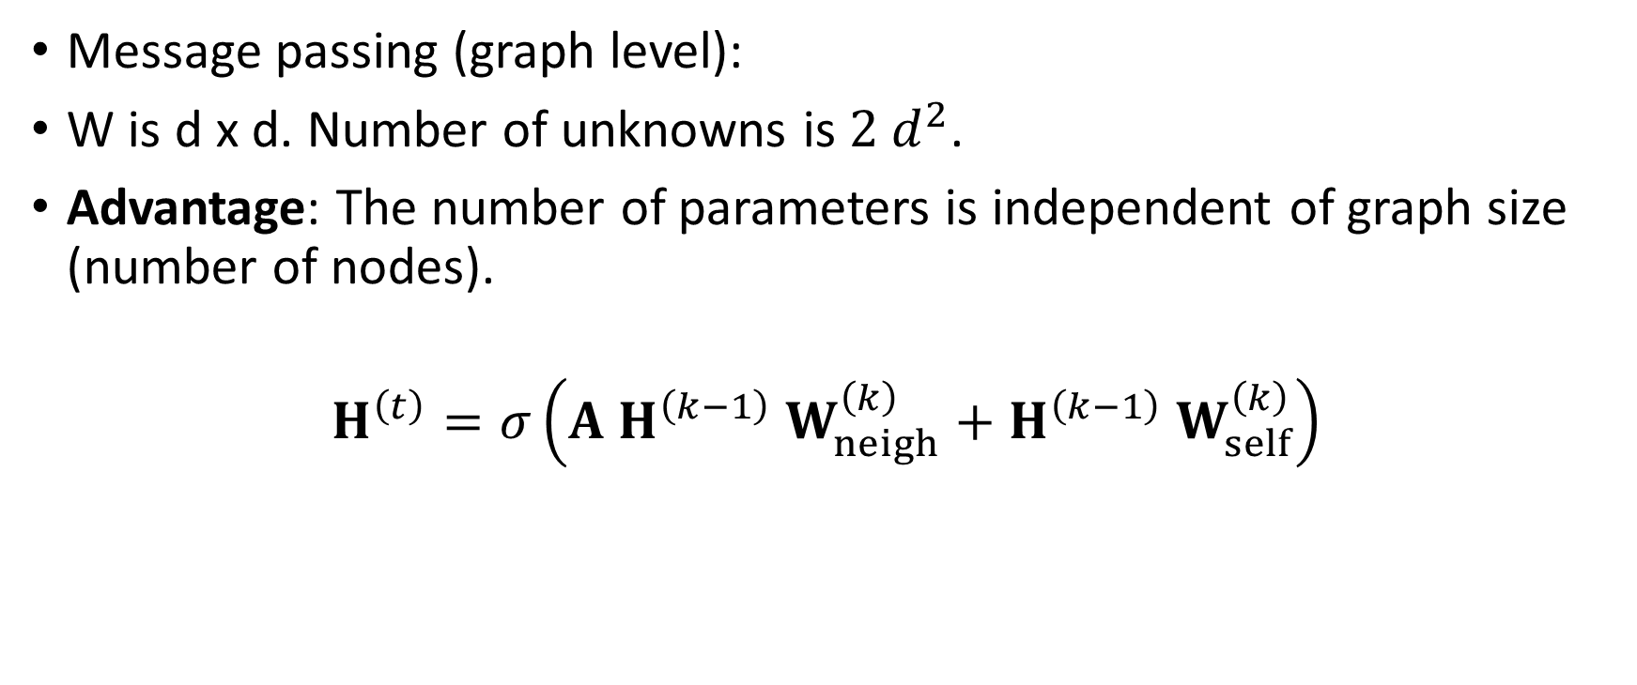
Neural Message Passing (continued)
Message passing (graph level):
W is d x d. Number of unknowns is $2 d^{2}$.
Advantage: The number of parameters is independent of graph size (number of nodes).
$$H^{\left(t\right)}=σ\left(A H^{\left(k−1\right)} W_{neigh}^{\left(k\right)}+H^{\left(k−1\right)} W_{self}^{\left(k\right)}\right)$$

Slide 46
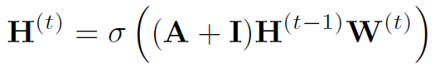
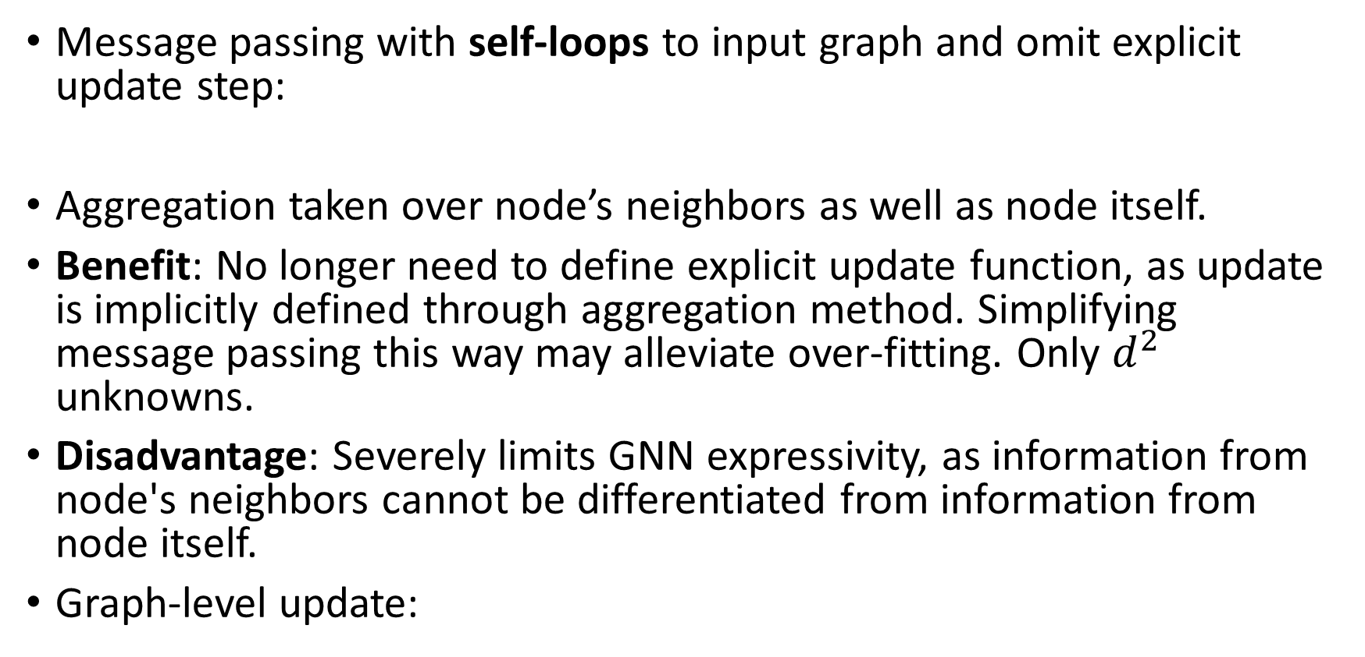
Neural Message Passing (continued)
Message passing with self-loops to input graph and omit explicit update step:
Aggregation taken over node’s neighbors as well as node itself.
Benefit: No longer need to define explicit update function, as update is implicitly defined through aggregation method. Simplifying message passing this way may alleviate over-fitting. Only $d^{2}$ unknowns.
Disadvantage: Severely limits GNN expressivity, as information from node's neighbors cannot be differentiated from information from node itself.
Graph-level update:

Slide 47
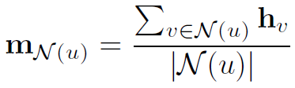
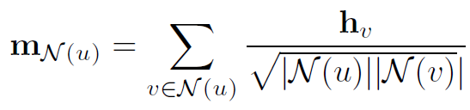
Generalized Neighborhood Aggregation
Neighborhood normalization:
Neighborhood aggregation (taking sum of neighbor embeddings) has a problem: it can be unstable and highly sensitive to node degrees.
Instability: when we iterate, there will be numerical problems.
Solution: normalize aggregation operation based upon degrees of nodes involved.
Average rather than sum:
Symmetric normalization:

Slide 48
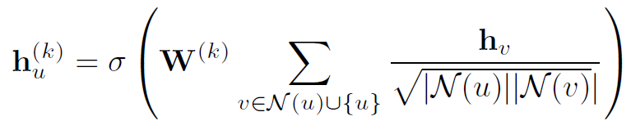
Generalized Neighborhood Aggregation (continued)
Graph convolutional networks (GCNs):
Employ symmetric-normalized aggregation and self-loop update approach.
N(u) = number of neighbors that node u has.

Slide 49
Generalized Neighborhood Aggregation (continued)
To normalize or not to normalize?
Proper normalization can be essential to achieve stable and strong performance when using GNN.
But normalization may also lead to loss of information.
E.g., after normalization, it can be hard to use learned embeddings to distinguish between nodes of different degrees, and other structural graph features may be obscured.
Thus, normalization is application-specific.
It is helpful in tasks where node feature information is more useful than structural information, or where there is wide range of node degrees that can lead to instabilities during optimization.

Slide 50
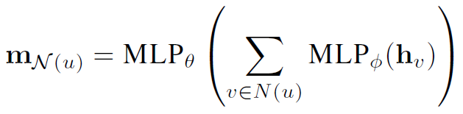
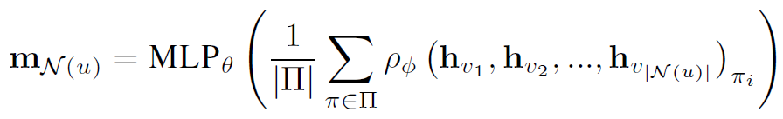
Generalized Neighborhood Aggregation (continued)
Set Aggregators:
There is no natural ordering of a nodes' neighbors. Any aggregation function must be permutation invariant.
Set pooling: Universal set function approximator.
Janossy pooling: Permutation-sensitive function and average the result over many possible permutations.

Slide 51
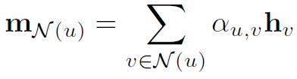
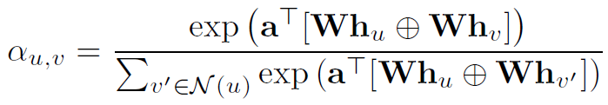
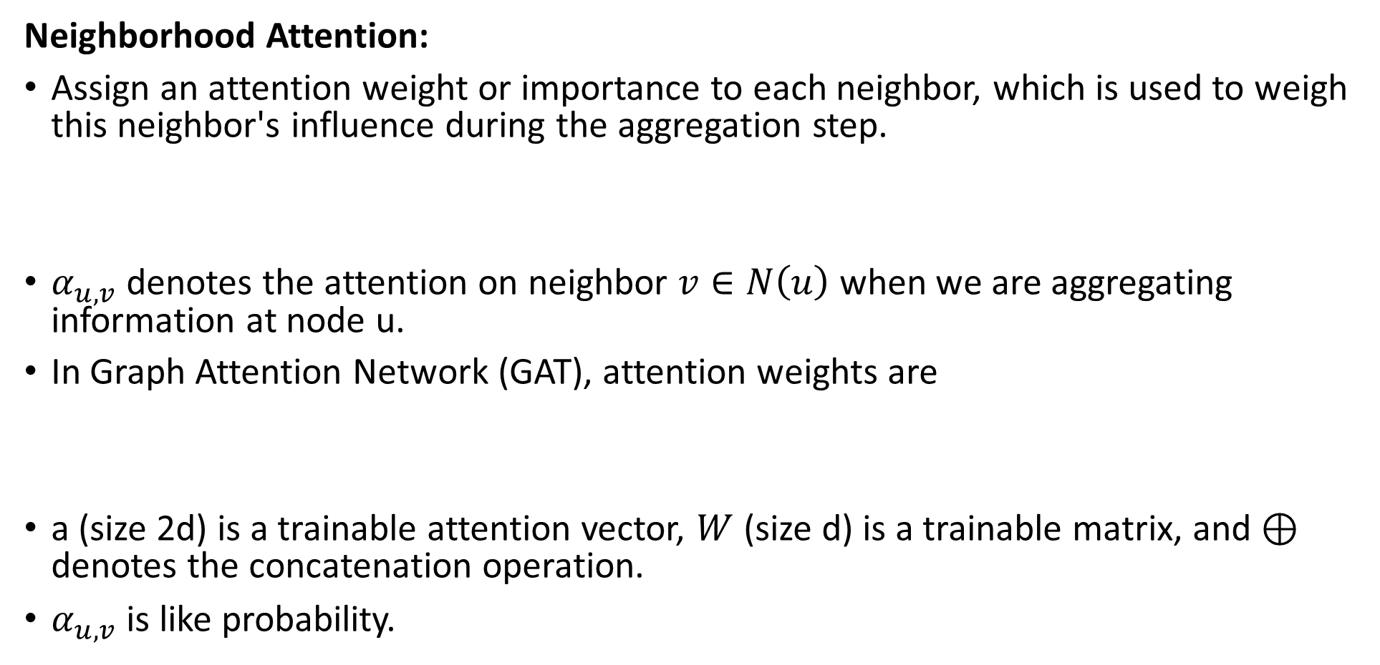
Generalized Neighborhood Aggregation (continued)
Neighborhood Attention:
Assign an attention weight or importance to each neighbor, which is used to weigh this neighbor's influence during the aggregation step.
$α_{u, v}$ denotes the attention on neighbor $v∈N\left(u\right)$ when we are aggregating information at node u.
In Graph Attention Network (GAT), attention weights are
a (size 2d) is a trainable attention vector, $W$ (size d) is a trainable matrix, and $⊕$ denotes the concatenation operation.
$α_{u, v}$ is like probability.

Slide 52
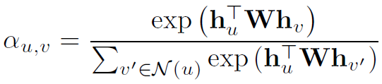
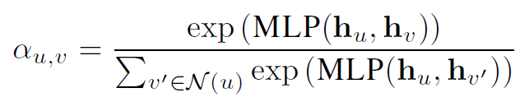
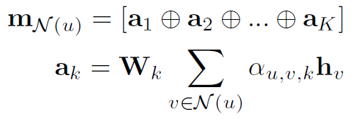

Generalized Neighborhood Aggregation (continued)
Bilinear attention model:
Variations of attention layers using multi layer perceptrons (MLPs):
Add multiple attention “heads": Compute K distinct attention weights $α_{u, v, k}$ using independently parameterized attention layers. Messages aggregated using different attention weights are then transformed and combined in aggregation step.

Slide 53
Generalized Update Methods
GNN message passing involves two key steps: aggregation and updating.
Earlier, we saw:
Basic GNN approach: Linear combination of node's current embedding with message from its neighbors.
Self-loop approach: Adding self-loop to graph before performing neighborhood aggregation.
More diverse generalizations of the UPDATE operator are possible.

Slide 54
Generalized Update Methods (continued)
Generalized update methods may help address over-smoothing.
Over-smoothing: after several iterations of GNN message passing, the representations for all the nodes in the graph can become very similar to one another.
Problematic: Makes it impossible to build deeper GNN models (which leverage longer-term dependencies in the graph) since these deep GNN models tend to just generate over-smoothed embeddings.

Slide 55

Generalized Update Methods (continued)
Theorem:
For any GNN model using self-loop update and aggregation function
$$AGGREGATE \left(\left\{h_{v}, ∀ v∈N\left(u\right)∪\left\{u\right\}\right\}\right)=\frac{1}{f_{n}\left(\left|N\left(u\right)∪\left\{u\right\}\right|\right)} \sum_{v∈N\left(u\right)∪\left\{u\right\}}{h_{v}}$$
where $f:ℝ^{+}⟶ℝ^{+}$ is an arbitrary differentiable normalization function, and || means number of elements in set. We have that
$$I_{K}\left(u, v\right) ∝ p_{G, K}\left(u|v\right)$$
where $p_{G, K}\left(u|v\right)$ is probability of visiting node v on a length-K random walk starting from node u, and $I_{K}\left(u, v\right)=1^{T} \left(\frac{∂h_{v}^{\left(K\right)}}{∂h_{u}^{\left(0\right)}}\right) 1$ is influence of node u on node v in GNN (1 is vector of all ones).
In other words, when we use a K-layer GCN-style model, the influence of node u and node v is proportional to the probability of reaching node v on a K-step random walk starting from node u.

Slide 56
Generalized Update Methods (continued)
When using simple GNN models (especially those with self-loop update approach), building deeper models may hurt performance.
As more layers are added, we lose information about local neighborhood structures and our learned embeddings become over-smoothed, approaching an almost-uniform distribution.

Slide 57

Generalized Update Methods (continued)
Concatenation and Skip-Connections:
Concatenation to preserve more node-level information during message passing:
where $m_{N\left(u\right)}$ is normalized aggregation of neighbors. We concatenate output of base update function with the node's previous-layer representation.
Linear interpolation method:
where $α_{1}, α_{2}∈{\left[0, 1\right]}^{d}$ are gating vectors with $α_{2}=1−α_{1}$, and $∘$ denotes elementwise multiplication.

Slide 58




Generalized Update Methods (continued)
Gated Updates:
where GRU denotes update equation of gated recurrent unit (GRU) cell.
Jumping Knowledge Connections:
Earlier, we assumed that node representations $z_{u}$ in downstream task are final layer node embeddings in GNN:
Complimentary strategy to improve quality of final node representations: Leverage representations at each layer of message passing, rather than only using final layer output.
Final node representations:
where $f_{JK}$ is arbitrary differentiable function.

Slide 59


Edge Features and Multi-Relational GNNs
Many applications where graphs are multi-relational or heterogenous (e.g., knowledge graphs).
Relational Graph Neural Networks:
Augment the aggregation function to accommodate multiple relation types by specifying separate transformation matrix per relation type:
where $f_{n}$ is a normalization function that can depend on both: neighborhood of node u, and neighbor v being aggregated over.
Attention and Feature Concatenation:
Given any base aggregation approach $AGGREGATE_{base}$, a strategy to leverage edge features is to define a new aggregation function as
where $e_{\left(u, τ, v\right)}$ denotes an arbitrary vector-valued feature for the edge $\left(u, τ, v\right)$.

Slide 60



Graph Pooling
Learn an embedding $z_{G}$ for the entire graph G.
Set pooling approaches:
Sum (or mean) of the node embeddings:
where $f_{n}$ is some normalizing function (e.g., identity function).
Combination of LSTMs and attention to pool the node embeddings:
Where $q_{t}$ vector represents query vector for attention at each iteration t.

Slide 61


Generalized Message Passing
GNN message passing approach can be generalized to leverage edge and graph-level information at each stage of message passing.
During message passing, we generate hidden embeddings $h_{\left(u,v\right)}^{\left(k\right)}$ for each edge in the graph, as well as an embedding $h_{G}^{\left(k\right)}$ corresponding to the entire graph.

Slide 62
Find a small data set with no more than 100 nodes, on which all this can be applied.

